Slide 1
03. CSS part one

Slide 2
Agenda
Introduction
CSS rule
CSS usage
CSS Selectors
Colors
Units
Text & font
Box model
Reset & normalize
SASS/SCSS

Slide 3

CSS
CSS stands for Cascading Style Sheets
CSS describes how HTML elements are to be displayed on screen, paper, or in other media
CSS is used to define styles for your web pages, including the design, layout and variations in display for different devices and screen sizes.

Slide 4
CSS rule

Slide 5
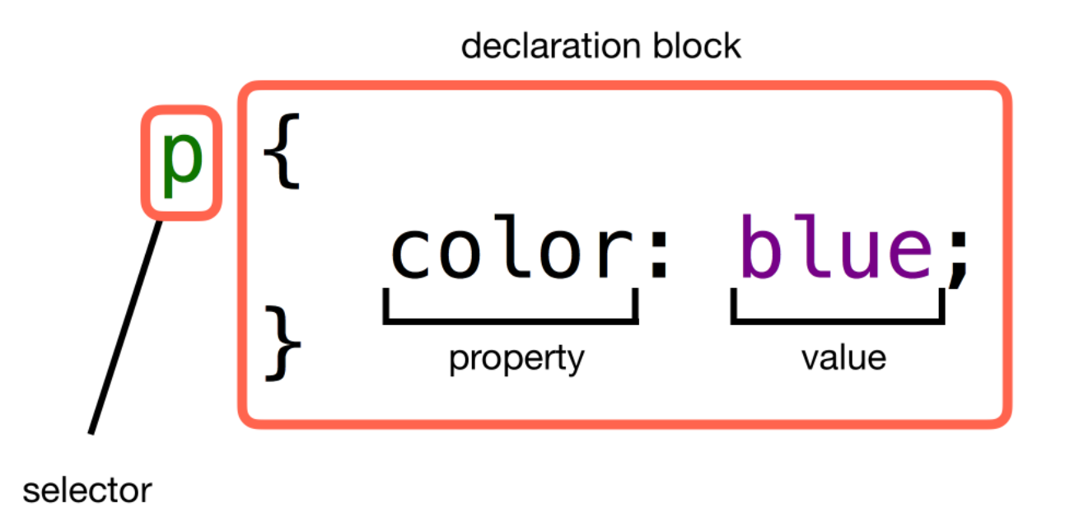
CSS rule
The selector points to the HTML element you want to style.
The declaration block contains one or more declarations separated by semicolons.
Multiple CSS declarations are separated with semicolons, and declaration blocks are surrounded by curly braces.

Slide 6
How to add CSS

Slide 7
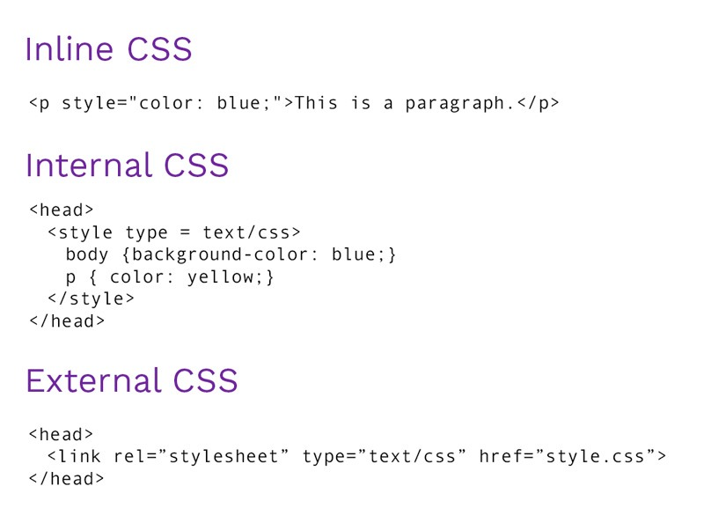
How to add CSS

Slide 8
Cascading order
Inline style
2. Internal and External stylesheets
3. Browser default
Note:
The best practice for styling HTML documents is the external stylesheet. It lets you set CSS rules for several files and is very easy to update.

Slide 9
CSS selectors

Slide 10
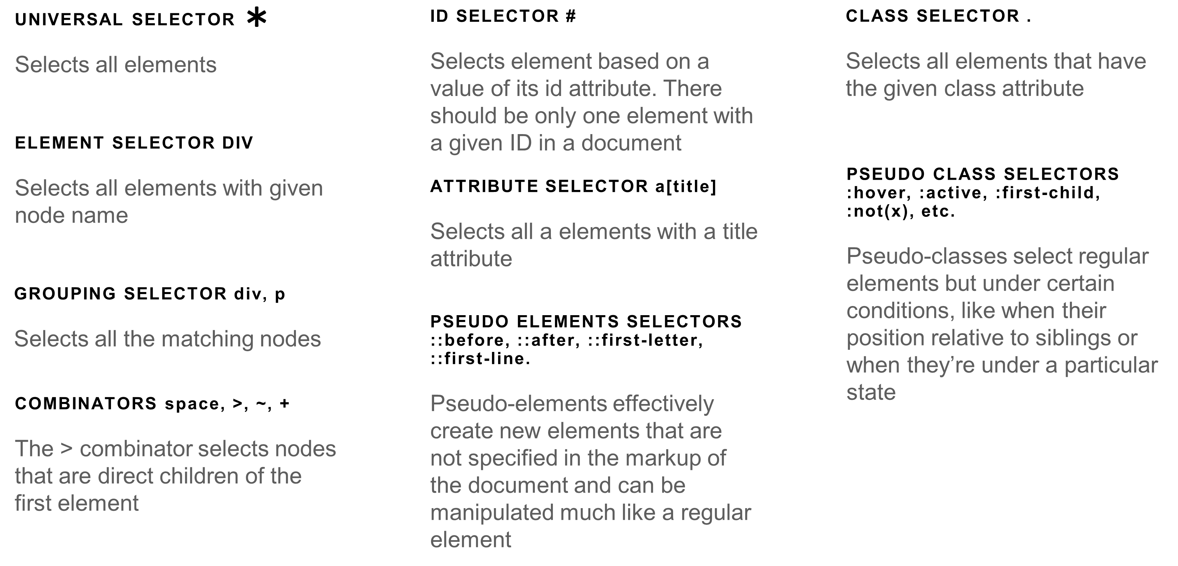
CSS Selectors

Slide 11
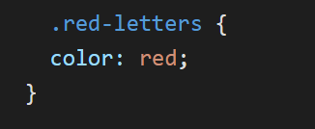
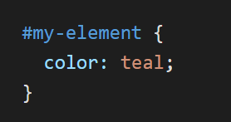
Best practices for CSS Selectors
Use classes to select elements that are more specific, reusable and flexible than type selectors.
ID values can only be used once per page, so stick to using them for unique styles and global elements that are not repeated.

Slide 12

Selector group priorities
1. The first priority group contains rules with the !important modifier added to them. They override all rules that do not contain this modifier.
2. The second priority group contains rules embedded in the style attribute of an HTML tag.
3. The third priority group contains rules that have one or more ID selectors.
4. The fourth priority group contains rules that have one or more class, attribute, or pseudo-selector.
5. The fifth priority group contains rules that have one or more element selectors.
6. And last, the sixth (and lowest) priority group contains rules that have only a universal selector.

Slide 13
Colors

Slide 14
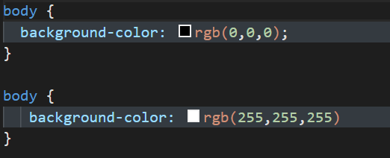
Colors CSS
Color names (red, blue, etc). These color names are generally referred to as color names and there are about 140 of these names - all valid.
RGB values (red, green, blue)
3. RGBA values The “A” after “RGB” in “RGBA” stands represents the color’s alpha channel. This specifies the opacity of the object. The alpha parameter is a number between 0.0 (fully transparent) and 1.0 (fully opaque).
4. HEX value The “Hex” in Hex value, refers to Hexademical.
The general format is #RRGGBB where R is Red, G is Green and B is Blue.
Unlike RGB values that span 0 - 255, hex values span 00 - FF where 00 is the lowest and FF the highest. Ex #FF0000 – red color.

Slide 15
Units

Slide 16
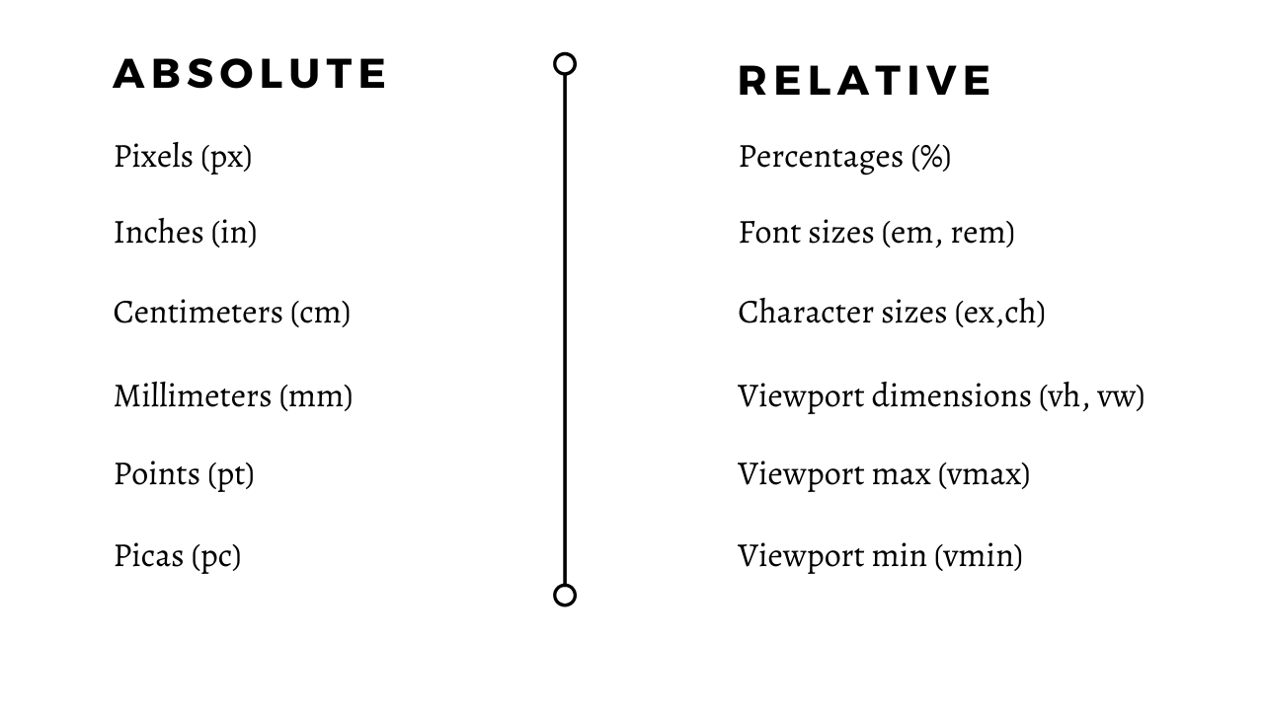
Units CSS

Slide 17
Units CSS
Absolute length units are based on an actual physical unit and are generally considered to be the same size across devices. However, depending on your screen size and quality, or settings in your browser or OS, there may be some exceptions.
Relative length units are relative to another element's size or settings. For example, the relative font size of an element may be calculated using the parent element's font size.

Slide 18
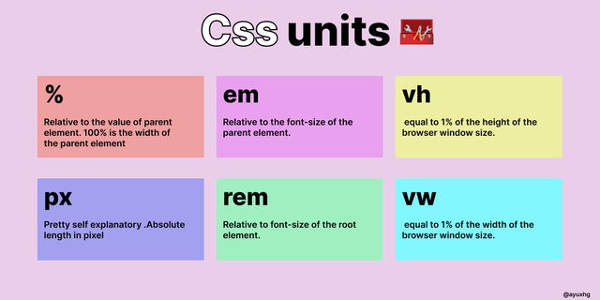
Units CSS

Slide 19
Text & Fonts

Slide 20
Text CSS
Text-alignment:
Use the text-align property to change the alignment of text within an element.
Text-align has four different values:
center: center the text
left: align the text to the left of its container
right: align the text to the right of its container
justify: the text will spread out to fill out the full width of its container
Text-color:
Color property
Text-sizes:
Font-size property (em, rem)
Text-decoration: text-decoration-line, text-decoration-color, text-decoration-style, text-decoration-thickness, text-decoration

Slide 21
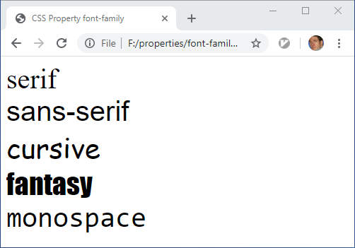
Fonts CSS
The font-family CSS property specifies a prioritized list of one or more font family names and/or generic family names for the selected element. The font-family property can hold several font names as a "fallback" system. If the browser does not support the first font, it tries the next font.
The font-family property specifies a list of fonts, from highest priority to lowest.
/* A font family name and a generic family name */
font-family: "Gill Sans Extrabold", sans-serif;
family-name - The name of a font-family, like "times", "courier", "arial", etc.
generic-family - The name of a generic-family, like "serif", "sans-serif", "cursive", "fantasy", "monospace.

Slide 22
Box model

Slide 23
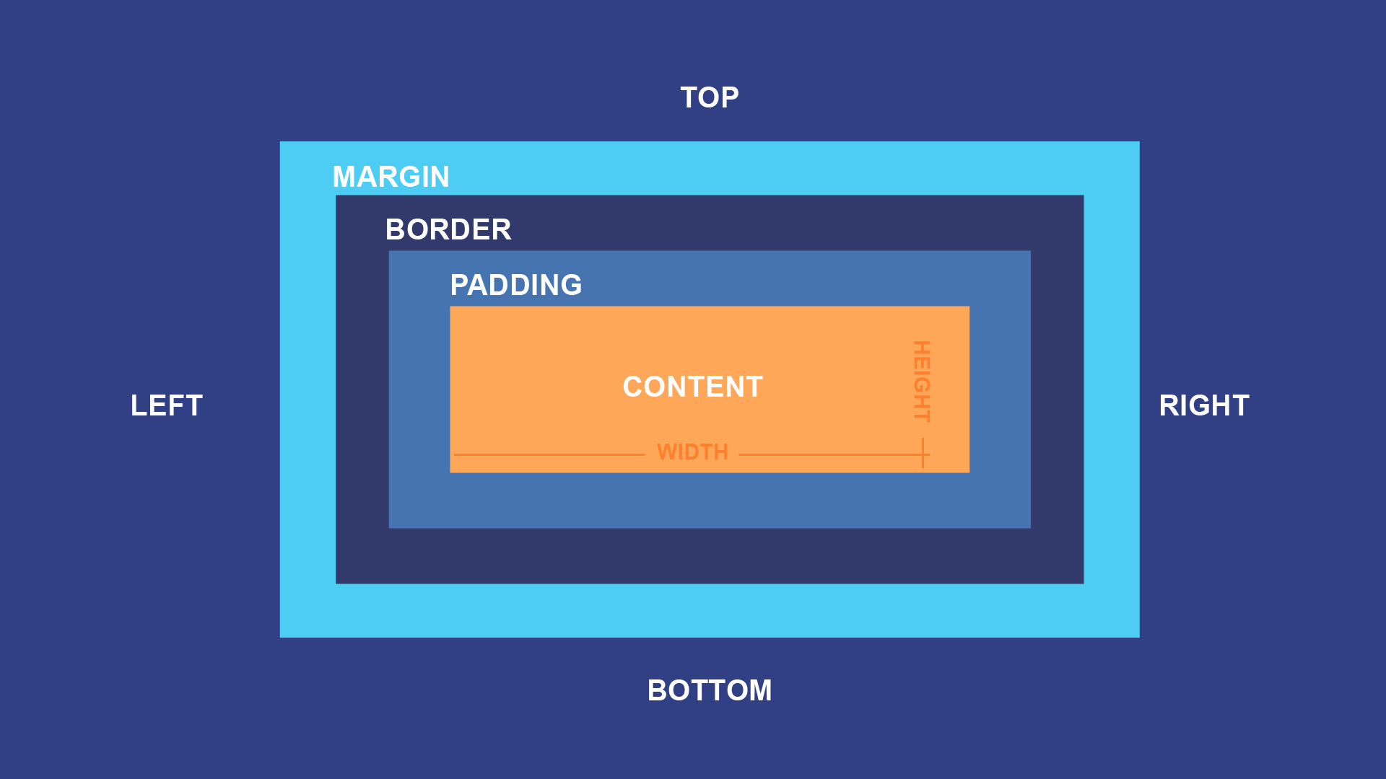
Box model

Slide 24
Reset and Normalize

Slide 25
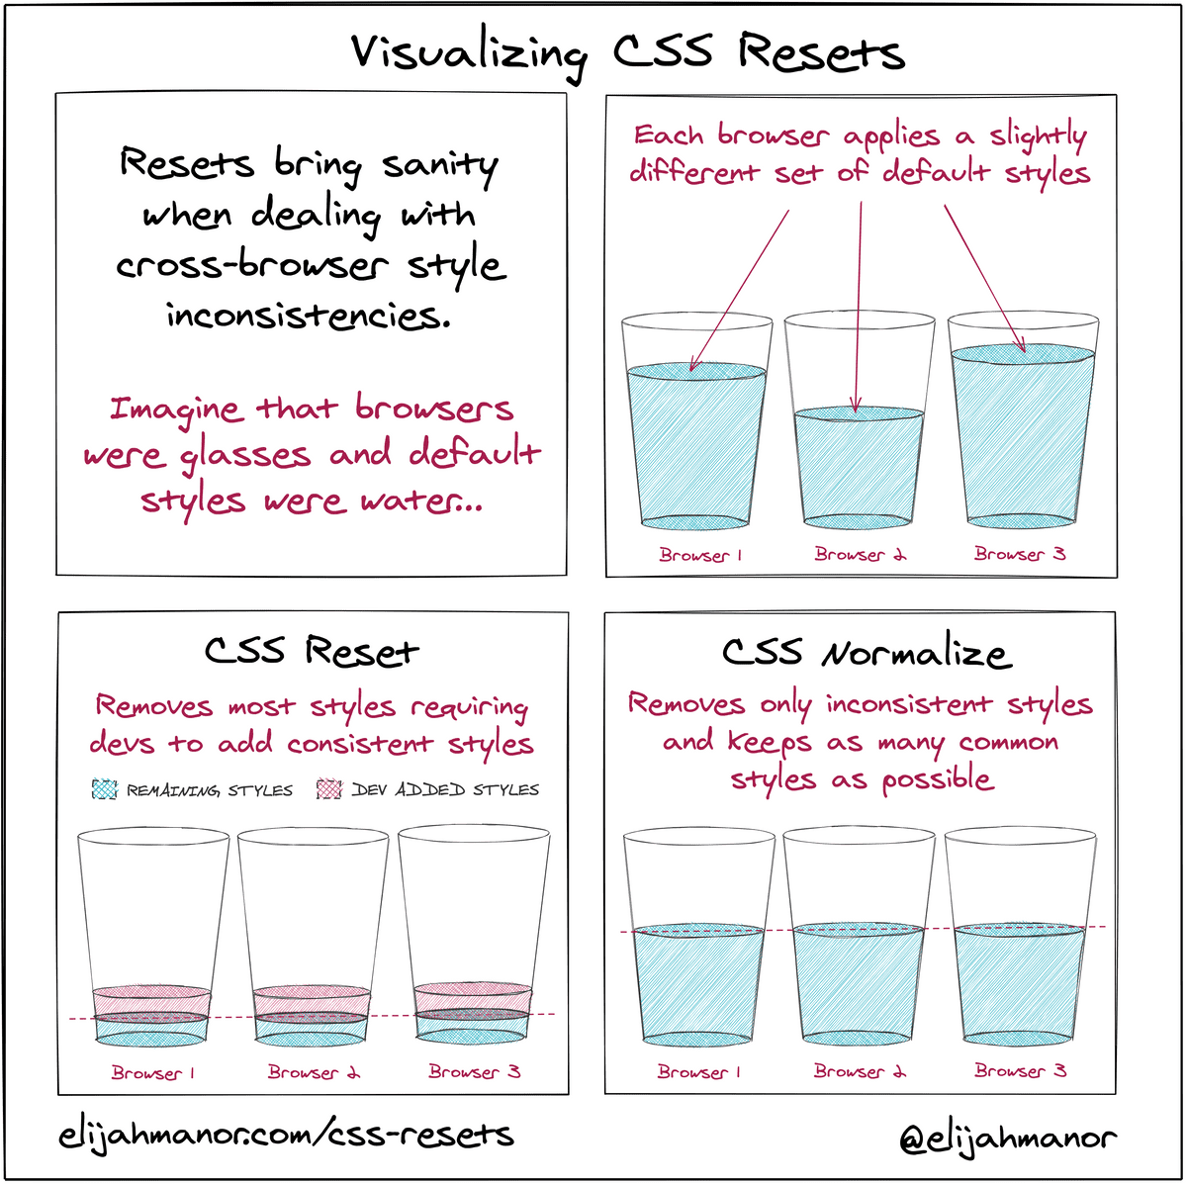
Reset and normalize

Slide 26
SASS/SCSS

Slide 27

SASS
Sass is the most mature, stable, and powerful professional grade CSS extension language in the world.
CSS on its own can be fun, but stylesheets are getting larger, more complex, and harder to maintain. This is where a preprocessor can help. Sass has features that don't exist in CSS yet like nesting, mixins, inheritance, and other nifty goodies that help you write robust, maintainable CSS.

Slide 28
Homework

